Slide 1
Why are Emerging Markets Still Emerging? December 2022 Peter K. Schott Yale School of Management & NBER

Slide 2
Agenda
Visualizing 40 years of development
Where does productivity come from?
How does firm productivity vary within and across countries?
Why don’t firms in emerging markets grow?
What does this mean for your organization?

Slide 3
Visualizing 40 years of development

Slide 4
The Global Labor Pool

Slide 5
The Global Labor Pool
The Global Labor Pool
Real Per Capita GDP (USD 000)
Population Share
Source: World Development Indicators and author’s calculations.

Slide 6
The Global Labor Pool
The Global Labor Pool
Real Per Capita GDP (USD 000)
India
Population Share
Source: World Development Indicators and author’s calculations.

Slide 7
The Global Labor Pool
The Global Labor Pool
Real Per Capita GDP (USD 000)
Kenya
India
Population Share
Source: World Development Indicators and author’s calculations.

Slide 8
The Global Labor Pool
The Global Labor Pool
Real Per Capita GDP (USD 000)
Nigeria
Kenya
India
Population Share
Source: World Development Indicators and author’s calculations.

Slide 9
The Global Labor Pool
The Global Labor Pool
United States
Real Per Capita GDP (USD 000)
Nigeria
Kenya
India
Population Share
Source: World Development Indicators and author’s calculations.

Slide 10
The Global Labor Pool
The Global Labor Pool
Real Per Capita GDP (USD 000)
Population Share
Source: World Development Indicators and author’s calculations.

Slide 11
The Global Labor Pool
The Global Labor Pool
Real Per Capita GDP (USD 000)
Population Share
Source: World Development Indicators and author’s calculations.

Slide 12
The Global Labor Pool
The Global Labor Pool
United States
Real Per Capita GDP (USD 000)
Nigeria
Kenya
India
Population Share
Source: World Development Indicators and author’s calculations.

Slide 13
The Global Labor Pool
The Global Labor Pool
United States
Real Per Capita GDP (USD 000)
Nigeria
Kenya
India
Population Share
Source: World Development Indicators and author’s calculations.

Slide 14
Where does growth come from?

Slide 15
Growth Accounting
ΔOutput = ΔProductivity * ΔInputs
Which matters more for long-run growth?
Increasing inputs?
Increasing productivity?
At the country level
Output = GDP
Inputs = {Capital, Labor}
Productivity is not observed directly!
Typically inferred as a “residual”
The change in output not explained by the change in inputs

Slide 16
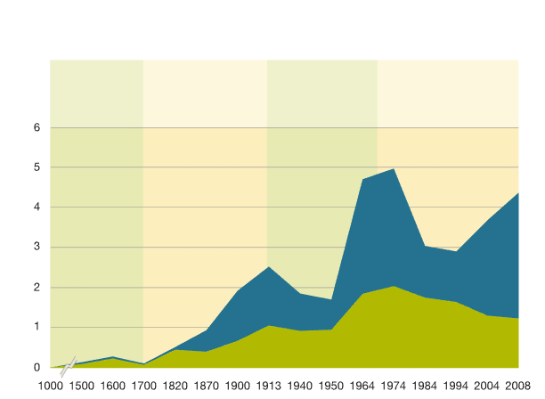
Productivity Contribution to World GDP Growth
Contribution to world GDP growth, GDP per capita vs population, years 1-2008,¹ compound annual growth rate (CAGR), %
Preindustrial era
Industrial Revolution begins in England and spreads across the Western world
WWI, Great Depression, WWII, and post-WWII boom
The rise of IT and emerging markets
CAGR %
GDP per capita
(productivity)
Population
Source: Madison Historical Statistics and McKinsey Global Institute.

Slide 17
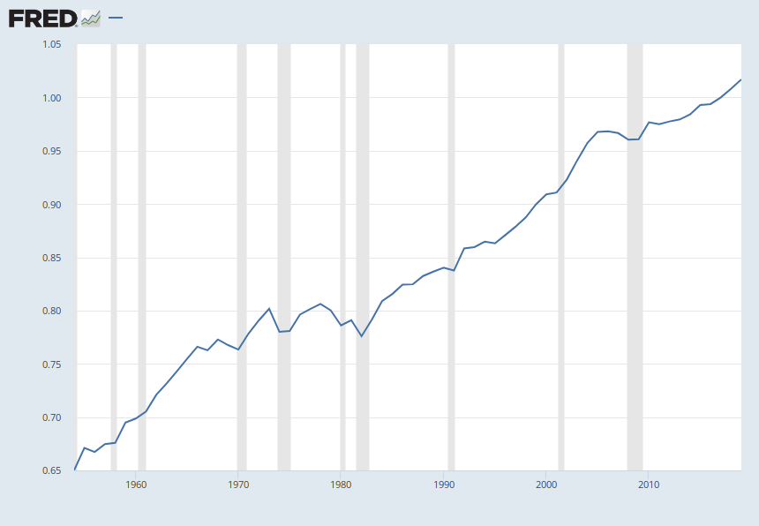
Example: Post-War US Productivity
Total Factor Productivity at Constant National Prices for United States
US Total Factor Productivity
Index 2017=1
Sources: University of Groningen; University of California, Davis
myf.red/g/Nz7k

Slide 18
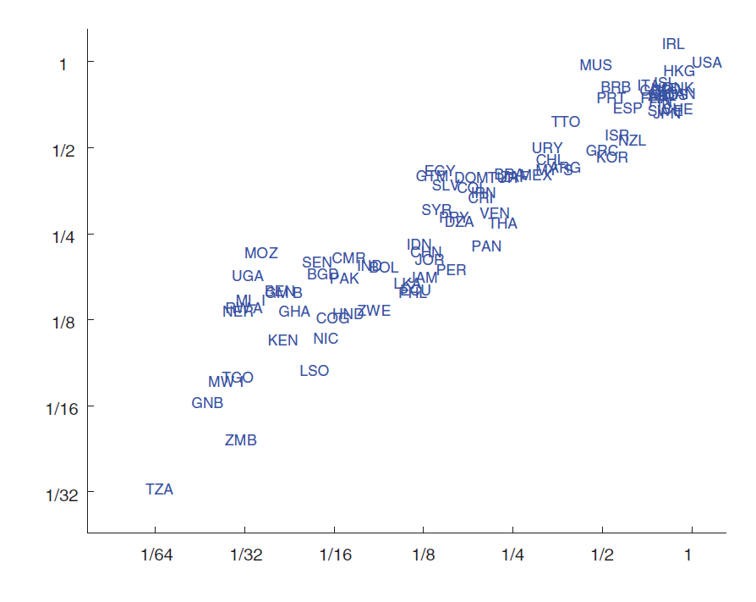
Productivity vs Per Capita GDP 2000
USA
Total factor productivity, 2000
Per capita GDP, 2000
Source: Jones and Romer (2012).

Slide 19
Productivity vs Per Capita GDP 2000
Total factor productivity, 2000
TFP varies widely across countries
Per capita GDP, 2000
Source: Jones and Romer (2012).

Slide 20
How does firm productivity vary across EMs?

Slide 21
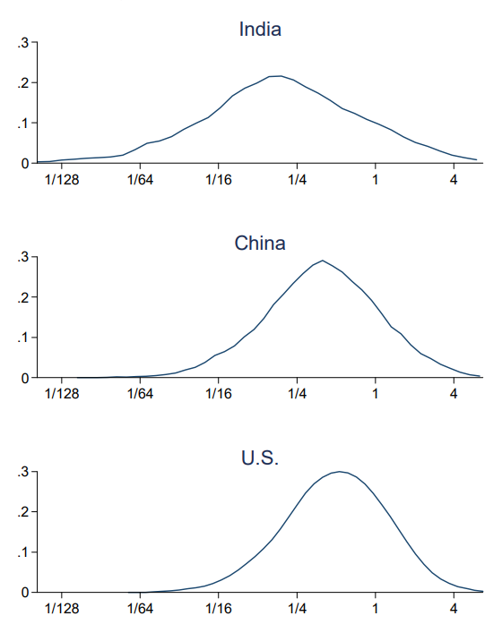
Productivity Within and Across Countries
India
China and India have a larger proportion of low-productivity firms than the US
China
U.S.
Productivity varies widely across firms in the US
Source: Hsieh and Klenow (2010).

Slide 22
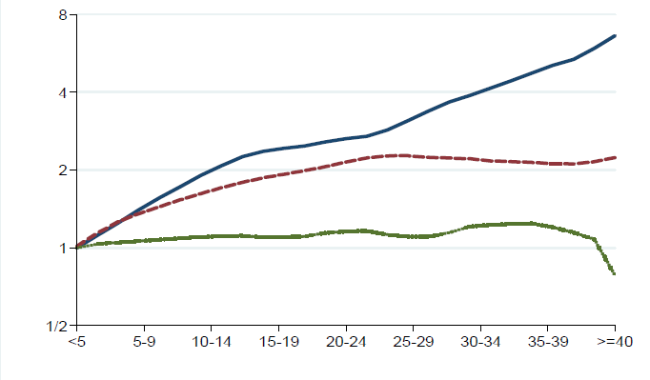
Firm Size and Age
In the US, a 40 year old firm employs ~8 times as many workers as a 5 year old firm.
US
Employment (Age < 5=1)
Age
Age
Source: Hsieh and Klenow (2010).

Slide 23
Firm Size and Age
In the US, a 40 year old firm employs ~8 times as many workers as a 5 year old firm.
US
Mexico
Employment (Age < 5=1)
India
But in emerging markets, older firms don’t get larger…WHY?
Age
Age
Source: Hsieh and Klenow (2010).

Slide 24
Firm Size Distribution in Ethiopia 2002
Just 0.7% of employment is at large firms, i.e., firms that have power
Source: Hsieh and Klenow (2010).

Slide 25
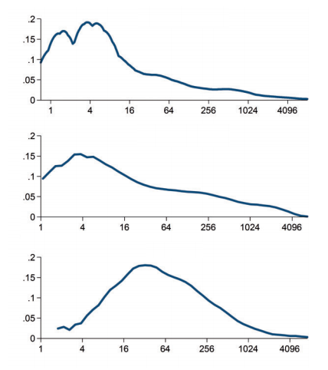
Firm Size by Country
U.S.
Employment

Slide 26
Firm Size by Country
U.S.
Share of Plants
India
Mexico
Employment

Slide 27
Firm Size by Country
U.S.
Share of Plants
India
Where are all the mid-sized Indian and Mexican firms?
Mexico
Employment

Slide 28
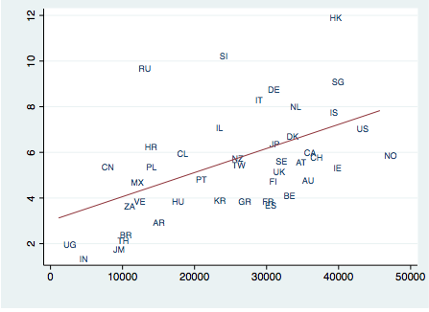
Average Firm Size vs Per Capita GDP (Among firms with <250 workers)
mean employment
GDP per capita
Poschke (2015)

Slide 29
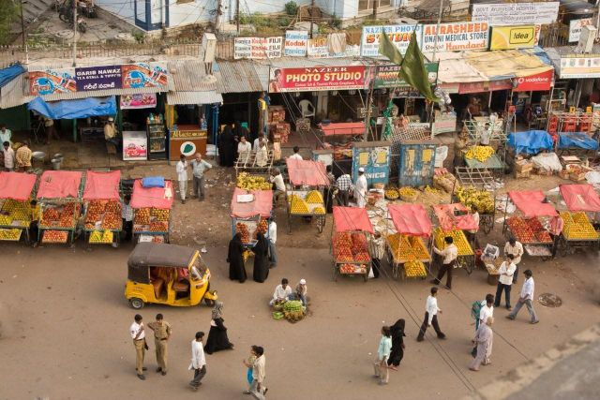
Why Don’t Emerging Market Firms Grow?

Slide 30
Why Don’t Emerging Market Firms Grow?
Financial constraints?

Slide 31
Financial Constraints?
Firms in emerging markets typically have three sources of capital:
Formal credit market
Informal credit market
Microfinance
Formal credit markets in emerging markets
Typically state-led
Emphasize “priority sectors” (e.g., agriculture)
Are more available for “insiders”
Characterized by inadequate credit rating agencies
Have a “market-for-lemons” problem

Slide 32
The “Market-for-Lemons” Problem
Think used cars, where it can be hard for buyers to verify quality
Best guess for any car is average quality
So, prices reflect average quality
Owners of above-average cars don’t sell
Buyers revise down their expected quality, and therefore price
And so on…
Market unravels
Similar for bank loans in emerging markets
Borrower quality hard to verify, so rates are high

Slide 33
The “Political Outsider” Problem Khwaja and Mian (2005)
Politically connected firms often get better credit
Example: Pakistan
Connectedness: are one or more directors elected officials?
Connected firms borrow 45% more (and have 50% higher default)
Their preferential treatment occurs exclusively via government banks; differences not observed at private banks
Results are stronger if director is from party in power, and fall with the degree of electoral participation in constituency
Economy-wide, the cost of politically connected lending is large!
Estimated to be 0.3 to 1.9% of GDP every year

Slide 34
Financial Constraints?
Firms in emerging markets typically have three sources of capital:
Formal credit market
Informal credit market: small loans, extremely high interest rates
Microfinance: not well-suited for firms

Slide 35
Why Don’t Emerging Market Firms Grow?
Financial constraints?
Management deficit?

Slide 36
How to Measure Managerial Capability?
Bloom et al. (2007) conduct extensive interviews of 20,000 medium-size companies in the US, Asia and Europe
Interviews are “double-blind”
Plant managers don’t know their practices were being evaluated
Interviewers don’t know anything about the firm
Interviewers surveyed four dimensions of management practices
Operations: documenting process improvements, JIT, etc
Monitoring: performance, workers, etc.
Targets: what types (e.g., financial), transparency, etc.
Incentives: promotion criteria, firing policies, etc.
Answers are compared to “best practices” identified by the management consulting industry

Slide 37
Interviewers Used Open-Ended Questions
“Tell me how your monitor your production process”
NOT: “Do you monitor your production processes?”
“Tell me about your promotion system”
“How do you identify and develop top performers”
“How are decisions made about promotions”
Can you describe the most recent promotion round”
NOT: “Do you actively identify, develop and promote top performers?”
Answers scored on scale of 1 to 5
1: promotions based on tenure with firm
5: pop performers are actively identified, developed and promoted

Slide 38
Average Score by Region Data Collected 2004-14
United States
3.308
Japan
3.230
Germany
3.210
Sweden
3.188
Canada
3.142
Great Britain
3.033
France
3.015
Australia
2.997
Italy
2.978
Mexico
2.899
Poland
2.887
Singapore
2.861
New Zealand
2.851
Northern Ireland
2.839
Portugal
2.826
Republic of Ireland
2.762
Chile
2.752
Spain
2.748
Greece
2.720
China
2.712
Turkey
2.706
Argentina
2.699
Brazil
2.684
Africa
India
2.611
Vietnam
2.608
Asia
Colombia
2.578
Kenya
2.549
Nigeria
2.516
Oceania
Nicaragua
2.397
Myanmar
2.372
Europe
Zambia
2.316
Tanzania
2.254
Latin America
Ghana
2.225
Ethiopia
2.221
Mozambique
2.027
North America
1.5
2
2.5
3
3.5
Source: Bloom et al. (2018)

Slide 39
Management Scores vs Development
3.5
Africa
Oceania
Asia
United States
Europe
Japan
Germany
Latin America
Sweden
North America
Canada
3
Italy
France
Australia
Poland
New Zealand
Average management practices
Mexico
Portugal
Singapore
Turkey
Chile
Spain
Republic of Ireland
China
Brazil
Argentina
Greece
Vietnam
India
2.5
Kenya
Colombia
Nigeria
Myanmar
Nicaragua
Zambia
Ethiopia
Tanzania
Ghana
2
Mozambique
7
8
9
10
11
Log Per Capita GDP

Slide 40
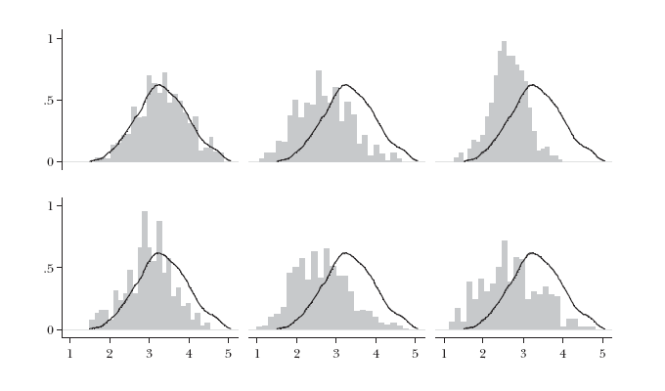
Scores Within and Across Countries
United States
Message 1
Management practices vary widely within countries
Fraction of firms
Firm-level average management scores, from 1 (worst practice) to 5 (best practice)
Notes:
Best 20% of firms in India performed better than the average US firm
75% of US firms are worse managed than the top 10% of Indian firms

Slide 41
Scores Within and Across Countries
United States
Superimpose the US distribution on all countries
Brazil
China
Fraction of firms
France
India
Southern Europe
Firm-level average management scores, from 1 (worst practice) to 5 (best practice)
Notes:
Best 20% of firms in India performed better than the average US firm
75% of US firms are worse managed than the top 10% of Indian firms

Slide 42
Scores Within and Across Countries
United States
Brazil
China
Fraction of firms
France
India
Southern Europe
Message 2: scores vary widely across countries, but there is substantial overlap;
Firm-level average management scores, from 1 (worst practice) to 5 (best practice)
Notes:
Best 20% of firms in India performed better than the average US firm
75% of US firms are worse managed than the top 10% of Indian firms

Slide 43
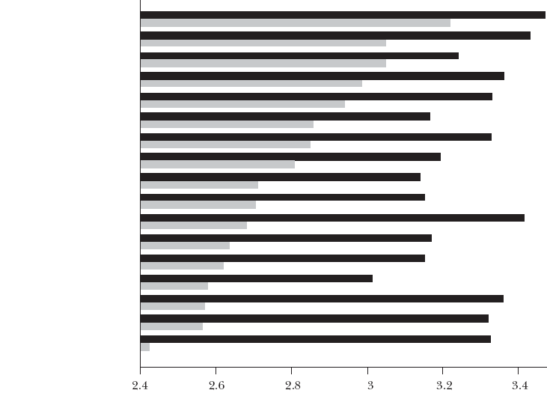
NOTE: Multi-Nationals are Well-Managed Everywhere
United States
Japan
Sweden
Germany
Canada
Australia
Italy
Great Britain
France
Poland
Northern Ireland
Republic of Ireland
India
China
Portugal
Brazil
Greece
Multinational Firm
Local Firm
Average Management Score

Slide 44
Does Management Consulting Help?

Slide 45
Management Practices g Performance? Bloom et al. 2010; see this video
To test whether performance differences are due to variation in management practices, Bloom et al. devised a field experiment which randomly assigned management advice to a set of Indian textile companies
Control group
Monitored before and after experiment, but not given any advice
Treatment group
Received free consulting services from a major international firm
Consultants evaluated factory operations, inventory control, quality control, human resources, planning and sales, and order management
Consultants then offered advice on how to run the firms more efficiently
Notes:
1.

Slide 46
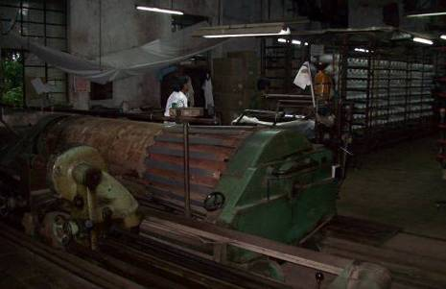
Background: Producing Textiles
1. Thread g Warp Beam
2. Drawing the Warp Beam
3. Weaving
3. Quality Check
Source: Bloom et al. 2010.

Slide 47
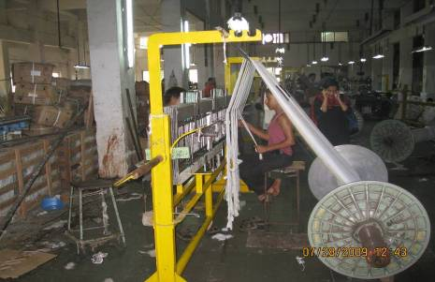
Background: Producing Textiles
1. Thread g Warp Beam
2. Drawing the Warp Beam
3. Weaving
3. Quality Check
Source: Bloom et al. 2010.

Slide 48
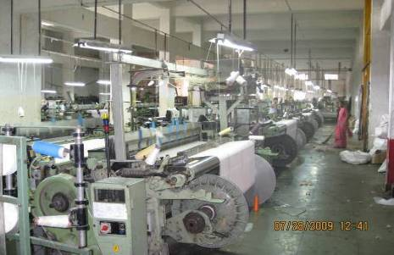
Background: Producing Textiles
1. Thread g Warp Beam
2. Drawing the Warp Beam
3. Weaving
3. Quality Check
Source: Bloom et al. 2010.

Slide 49
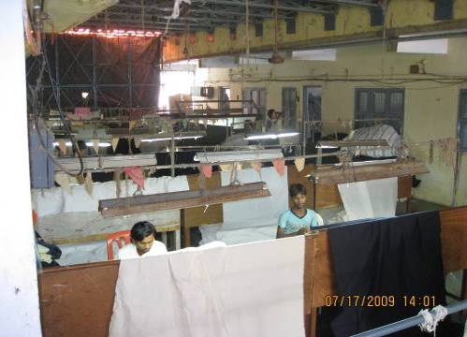
Background: Producing Textiles
1. Thread g Warp Beam
2. Drawing the Warp Beam
3. Weaving
3. Quality Check
Source: Bloom et al. 2010.

Slide 50
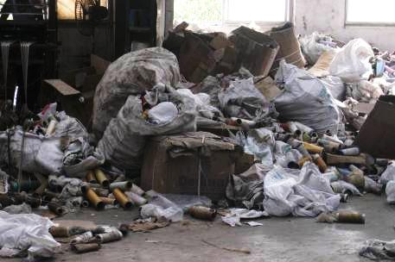
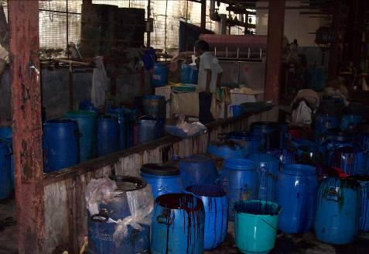
Evaluation
Consultants documented a range of poor management practices
For example:
Piles of garbage inside and outside plants
Poor storage of flammable chemicals
Large, disorganized inventories
Disorganized quality control
Etc…
Source: Bloom et al. 2010.

Slide 51
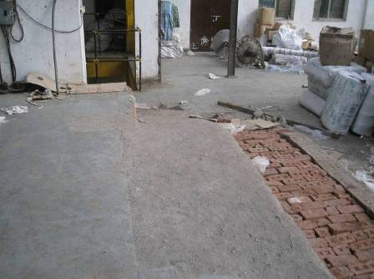
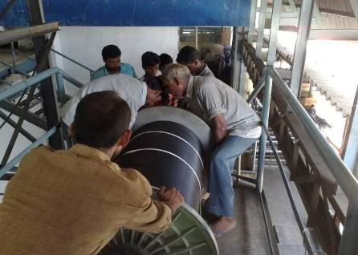
Example: Dangerous, Inefficient Use of Labor
Unfinished rough path along which 0.6 ton warp beams transferred by 6 men on wheeled trolleys every day
Workers often lost control of the trolleys, which crash into the wall and break
At this plant, both warp beam elevators had broken down due to poor maintenance
So, teams of 7 were needed to carry warp beams down the stairs several times/day
Serious accidents occurred during the researchers’ time at the plant
Source: Bloom et al. 2010.

Slide 52
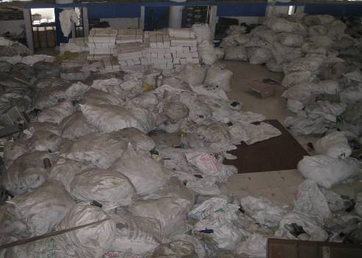
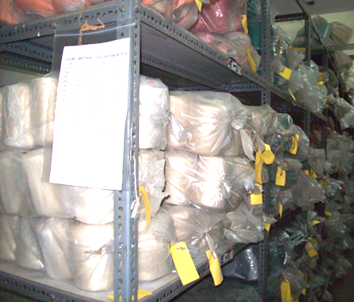
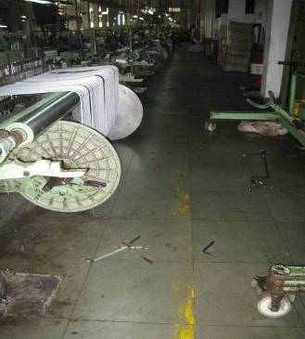
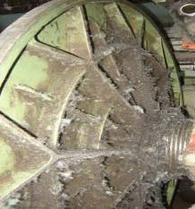
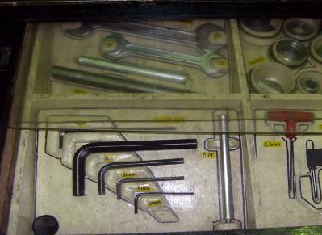
BeforegAfter
Inventory
Tools/ Repair
Source: Bloom et al. 2010.

Slide 53
Other Advice Given to “Treated” Firms
Factory operations
Maintain machines rather than repair once they break
Record repairs, downtime and quality data to learn patterns
Keep the factory floor tidy, organized
Inventory
Record yarn stocks on a daily basis; sort, label and store correctly
Planning
Plan loom usage 2 weeks in advance to ensure prepared warp beams are available for looms as needed
Human-resource management
Introduce a performance-based incentives system for workers and managers
Sales and order management
Track production on an order-wise basis to prioritize customer orders with the closest delivery deadline

Slide 54
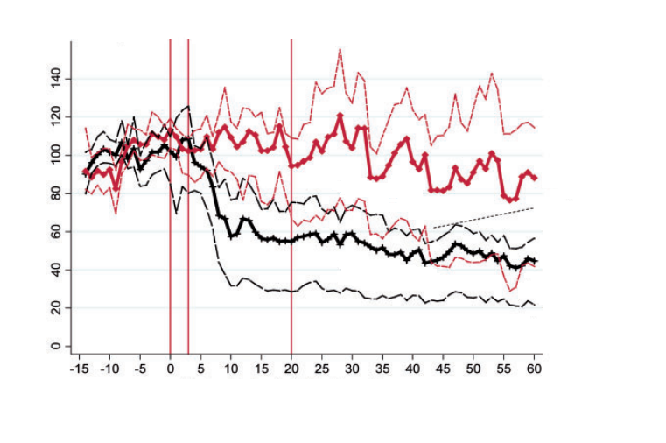
Results: Quality Defects
Start of Diagnostic
Start of Implementation
End of Implementation
Private Equity
97.5th percentile
Control plants
Average
Quality defects index (higher score=lower quality)
2.5th percentile
97.5th percentile
Treatment plants
Average
2.5th percentile
Weeks after the start of the diagnostic
FIGURE VI
Source: Bloom et al. 2013.

Slide 55
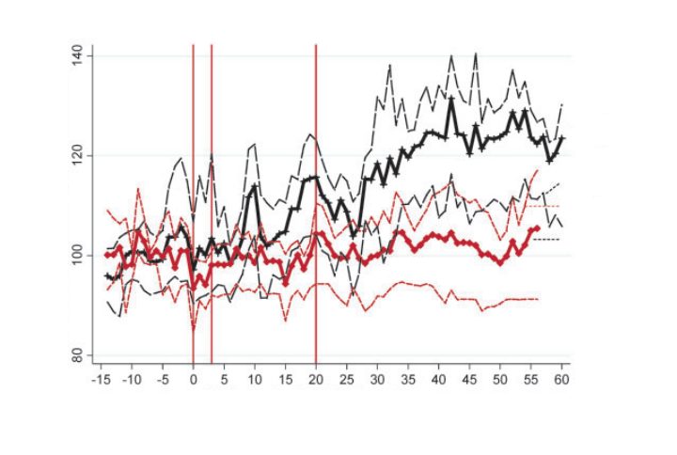
Results: Yarn Inventory
Start of Diagnostic
Start of Implementation
End of Implementation
97.5th percentile
Average
Treatment plants
2.5th percentile
Total factor productivity (normalized to 100 prior to diagnostic)
97.5th percentile
Average
Control plants
2.5th percentile
Weeks after the start of the diagnostic
FIGURE VIII
Source: Bloom et al. 2013.

Slide 56
Conclusion and …. More Questions?
Dissemination of management “best practices” clearly improves firm performance
Puzzle:
If the returns to adopting best practices are so high, why is adoption so low?
Why don’t more firms hire consultants?

Slide 57
Why Don’t Emerging Market Firms Grow?
Financial constraints?
Management practices?
Trust?

Slide 58
Do Emerging Markets Suffer Lack of Trust?
Firms in emerging markets tend to be more hierarchical
Owners handle more functions of the business
For example, every purchase requires owner’s signature
One explanation for this is a lack of trust (i.e., an agency problem)
Low trust inhibits delegation
Less delegation inhibits expansion
(Think Adam Smith’s pin factory)

Slide 59
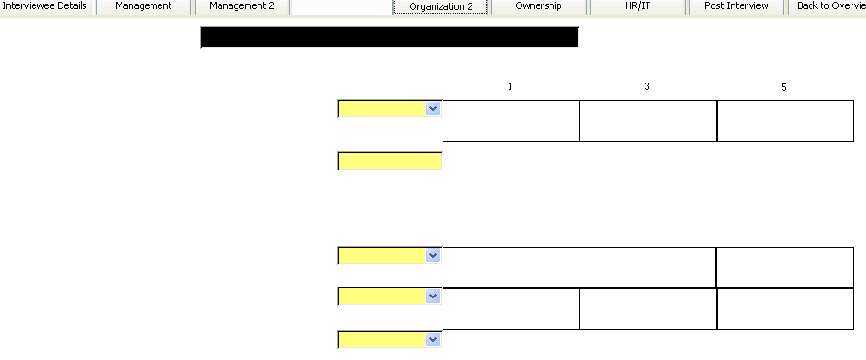
Measuring Decentralization
Company Name
WUZHI LVYU CHEMICAL & ELECTRIC CO.LTD.
Scoring
To hire a FULL-TIME PERMANENT SHOPFLOOR worker what agreement would your plant need from CHQ?
No authority - even for replacement hires
Requires sign-off from CHQ based on the business case. Typically agreed (i.e. about 80 or 90% of the time).
Complete authority - it is my decision entirely
Where are decisions taken on new product introductions - at the plant, at the CHQ or at both?
All new product introduction decisions taken at the CHQ
New product introductions are jointly determined by the plant and CHQ
All new product introduction decisions take at the plant level
How much of sales and marketing is carried out at the plant level (rather than at CHQ)?
None - sales and marketing is all run by CHQ
Sales and marketing decisions are split between the plant and CHQ
The plant runs all sales and marketing

Slide 60
Measuring Trust
World Value Survey
10,000s of individuals from different countries
Question:
“Generally speaking, would you say that most people can be trusted?”
What share of people answer yes to first part of the question?
Experiments show this share is associated with trusting behavior

Slide 61
Firm Size vs Trust
Share of Firms with <100 Employees
Employment Share
World Values Trust Measure
Employment data from World Bank Enterprise
Source: World Value Survey and World Bank. Circle size indicates country GDP.

Slide 62
Family Firms and Trust
Small firms tend to be family-run firms
Emerging markets tend to have high shares of family-run firms
If trust is lacking,
Owners rely on family members
Firm size limited to number of males
Owners quickly hit span of control problem, limiting size/growth
Most productive firms don’t expand!
More broadly
No jobs for middle managers!
Everyone wants to run their own business!
Too many entrepreneurs!

Slide 63
Management Scores, by CEO Type
Dispersed Shareholders
Private Equity
Family owned, non-family CEO
Managers
Private Individuals
Government
Family owned, family CEO
Founder owned, founder CEO
2.7
2.8
2.9
3
3.1
3.2

Slide 64
Conclusions?
Financial constraints?
Management practices?
Trust?
What do you think?

Slide 65
Thanks!

Slide 66
Appendix

Slide 67
How is productivity (TFP) measured?

Slide 68
TFP is Measured as a Residual
Consider the production function Y = A K^{α} L^{1-α}
This year: Y_{t} = A_{t} K_{t}^{α} L_{t}^{1-α}
Next year: Y_{t+1} = A_{t+1} K_{t+1}^{α} L_{t+1}^{1-α}
Then
Y_{t+1}/Y_{t} = A_{t+1}/A_{t} * (K_{t+1}/K_{t}) ^{α} * (L_{t+1}/L_{t}) ^{1-α}
ln(Y_{t+1}/Y_{t}) = α ln(K_{t+1}/K_{t} ) + (1-α) ln(L_{t+1}/L_{t} ) + ln(A_{t+1}/A_{t} )
ln(Y_{t+1}/Y_{t}) = α ln(K_{t+1}/K_{t} ) + (1-α) ln(L_{t+1}/L_{t} ) + ε
ε = ln(Y_{t+1}/Y_{t}) - α ln(K_{t+1}/K_{t} ) - (1-α) ln(L_{t+1}/L_{t} )

Slide 69
Productivity per Employee

Slide 70
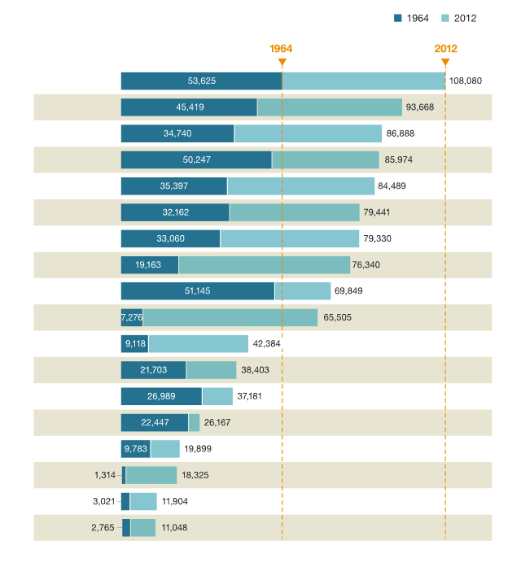
Progress toward productivity benchmarks,¹ GDP per employee in 1964 and 2012, $
United States
Australia
France
Canada
United Kingdom
Germany
Italy
Japan
Saudi Arabia
South Korea
Turkey
Argentina
Mexico
South Africa
Brazil
China
Indonesia
India
¹Excludes Russia because of lack of historical data.
Source: Conference Board and McKinsey Global Institute.

Slide 71
CEO Styles

Slide 72
CEO Time-Use Study Prat (2???)
New study examines how CEOs spend their time
Contacted the CEO firms to get authorization
Collect detailed time-use data for one (random) week
Collect any activity longer than 15 minute
Data entered by CEO’s personal assistant
Survey covers both activities on a given day as well as scheduled activities for the next day
Initial results focus on India
Being extended to UK, USA, Brazil, France

Slide 73
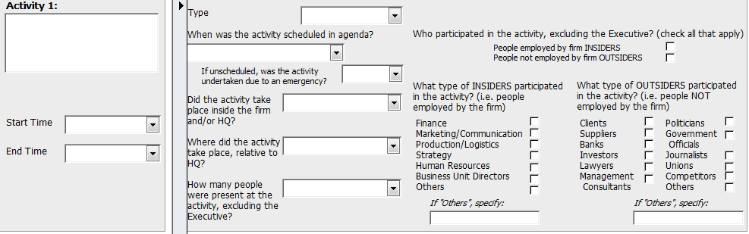
CEO Time-Use Study

Slide 74
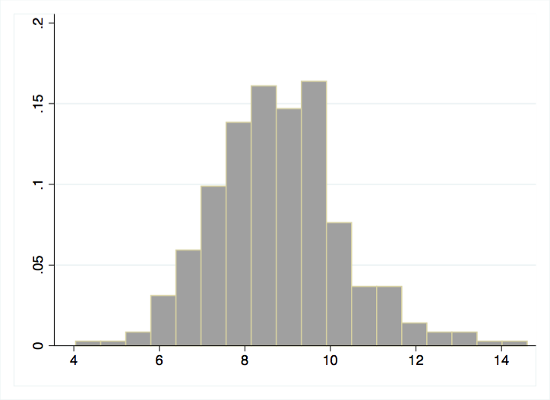
Wide Variation in Hours Worked/Day
Fraction
Average number of hours worked in a day

Slide 75
CEO Time-Use Study
Data suggest two CEO styles that do not seem to vary by industry
Style 1:
More activities planned in advance
More time spent at the firm, in meetings
Less time spent dealing with production, more time spent with wide range of functions at the firm
Style 2
Less time on activities planned in advance
Relatively more time dealing with production vs other functions
Style 1 is associated with 50 percent higher productivity

Slide 76
CEO Time-Use Study
Explanations
CEO style varies with conditions?
CEO style causes different performance?
Style 1 is more likely among CEOs at
Large firms
Multinationals
Exporters
Style 2 is more likely among
2nd generation family CEOs

